Slide 1
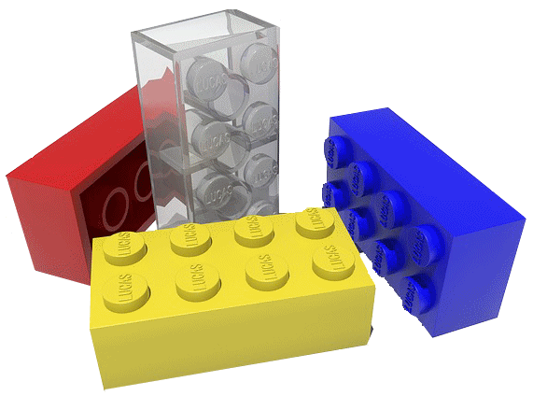
Building a Christ-Like Character
Colossians 3:1-17
Notes:
Colossians 3:1-17 gives us the building blocks we need in order to develop Christ-like character. This passage teaches us how to build Bible character.
When one is baptized into Christ he is “raised with Christ” by the power of God from the death of sin into newness of life (Col. 3:1; 2:12; Rom. 6:4).
To build Bible character, once a person has become a Christian, he must”
Seek things that are above, Col. 3:1
Set his mind on heavenly things, Col. 3:2
Sustain a faithful life with Christ, Col. 3:3.

Slide 2
How to Build a Christ-Like Character
A New Approach to Sin (5-11)
Notes:
Developing a Christ-Like Character requires the following:
A new approach to sin is necessary in order to build a new character in Christ: sin must be put to death (Col. 3:5-11).
We cannot continue to live in past sins and expect God to bless us.
We must cease sin, whether it is the sensual desires of the flesh (3:5-7)
Or the attitudes and actions that hurt others (3:8-9)
We must put off the old man of sin and put on the new man that is like Christ (3:10-11)

Slide 3
How to Build a Christ-Like Character
A New Approach to Sin (5-11)
A New Heart (12-15)
Notes:
Developing a Christ-Like Character requires the following:
A new heart is necessary in order to develop this new approach to sin (Col. 3:12-15).
(Proverbs 23:7), “For as he thinks in his heart, so is he. "Eat and drink!" he says to you, but his heart is not with you.”
Just as in Proverbs 23:7, the gospel teaches, “a good man out of the good treasure of his heart brings forth good things, and an evil man out of the evil treasure brings forth evil things” (Matt. 12:35).
Only as we put on a new heart will we also put off sin.
Character building involves rebuilding our heart so that we think and feel and act like Christ.

Slide 4
How to Build a Christ-Like Character
A New Approach to Sin (5-11)
A New Heart (12-15)
A New Message (16)
Notes:
Developing a Christ-Like Character requires the following:
A new message must dwell in one’s heart to truly build a new heart (Col. 3:16).
The word of Christ must be implanted deeply within one’s heart in order to build a character that is like Christ
(James 1:21-25), “Therefore lay aside all filthiness and overflow of wickedness, and receive with meekness the implanted word, which is able to save your souls. ²² But be doers of the word, and not hearers only, deceiving yourselves. ²³ For if anyone is a hearer of the word and not a doer, he is like a man observing his natural face in a mirror; ²⁴ for he observes himself, goes away, and immediately forgets what kind of man he was. ²⁵ But he who looks into the perfect law of liberty and continues in it, and is not a forgetful hearer but a doer of the work, this one will be blessed in what he does.”

Slide 5
How to Build a Christ-Like Character
A New Approach to Sin (5-11)
A New Heart (12-15)
A New Message (16)
A New Authority (17)
Notes:
Developing a Christ-Like Character requires the following:
A new authority must be respected and honored in all we say and do in order to let the word of Christ dwell in our heart. (Col. 3:17).
Next section of text (3:18-4:2) details the new conduct (by Christ’s authority) that we should have in our relationships with others

Slide 6
Conclusion
Possessing Bible character is a sign of strength. It is the inner strength of faith that stands fast in the face of adversity, trial and temptation.
Notes:
These are the building blocks of Bible character.
Stated another way, as we grow and mature in Christ we will be building godly character that pleases God.
When a Christian’s faith is tested and he patiently endures, God is pleased!
That “approved character” results (Rom. 5:3-4).
(Romans 5:3-4), “And not only that, but we also glory in tribulations, knowing that tribulation produces perseverance; ⁴ and perseverance, character; and character, hope.”

